Slide 1


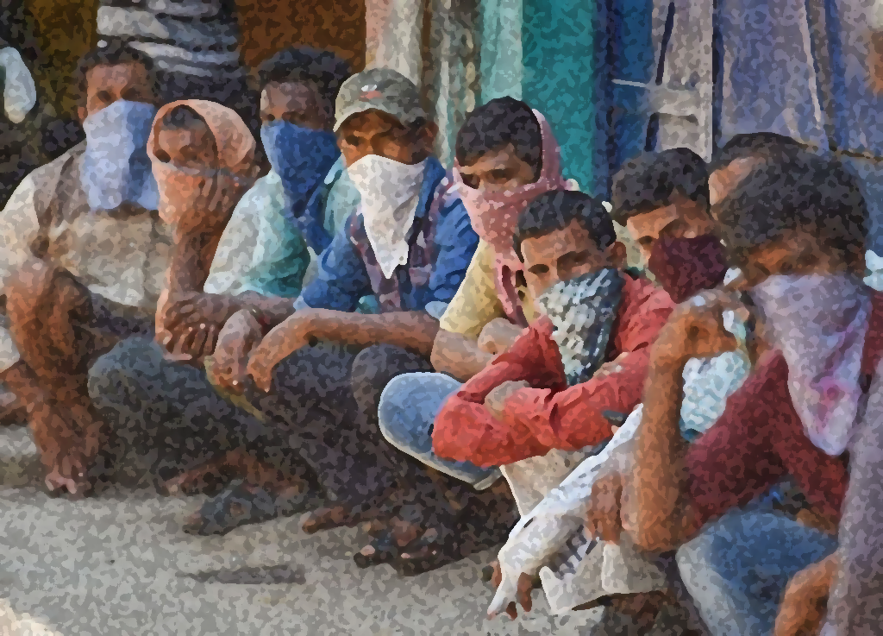
New L. J. Institute of Engineering and Technology
Gujarat Technological University, Ahmedabad
Exploring Emerging Technologies
“YOUTH EMPLOYMENT OPPORTUNITIES”
Head of Department
Mr Saurin Dave
Guided by
Ms Pooja Vyas
Prepared by
Unnati Jagdish Parikh (201430142005)
Diya Rakeshkumar Bodiwala (201430142062)
Kshiti Pranav Mulani (201430142077)
Shashvi Kaushalbhai Shah (201430142127)
This Photo by Unknown Author is licensed under CC BY-SA-NC

Slide 2
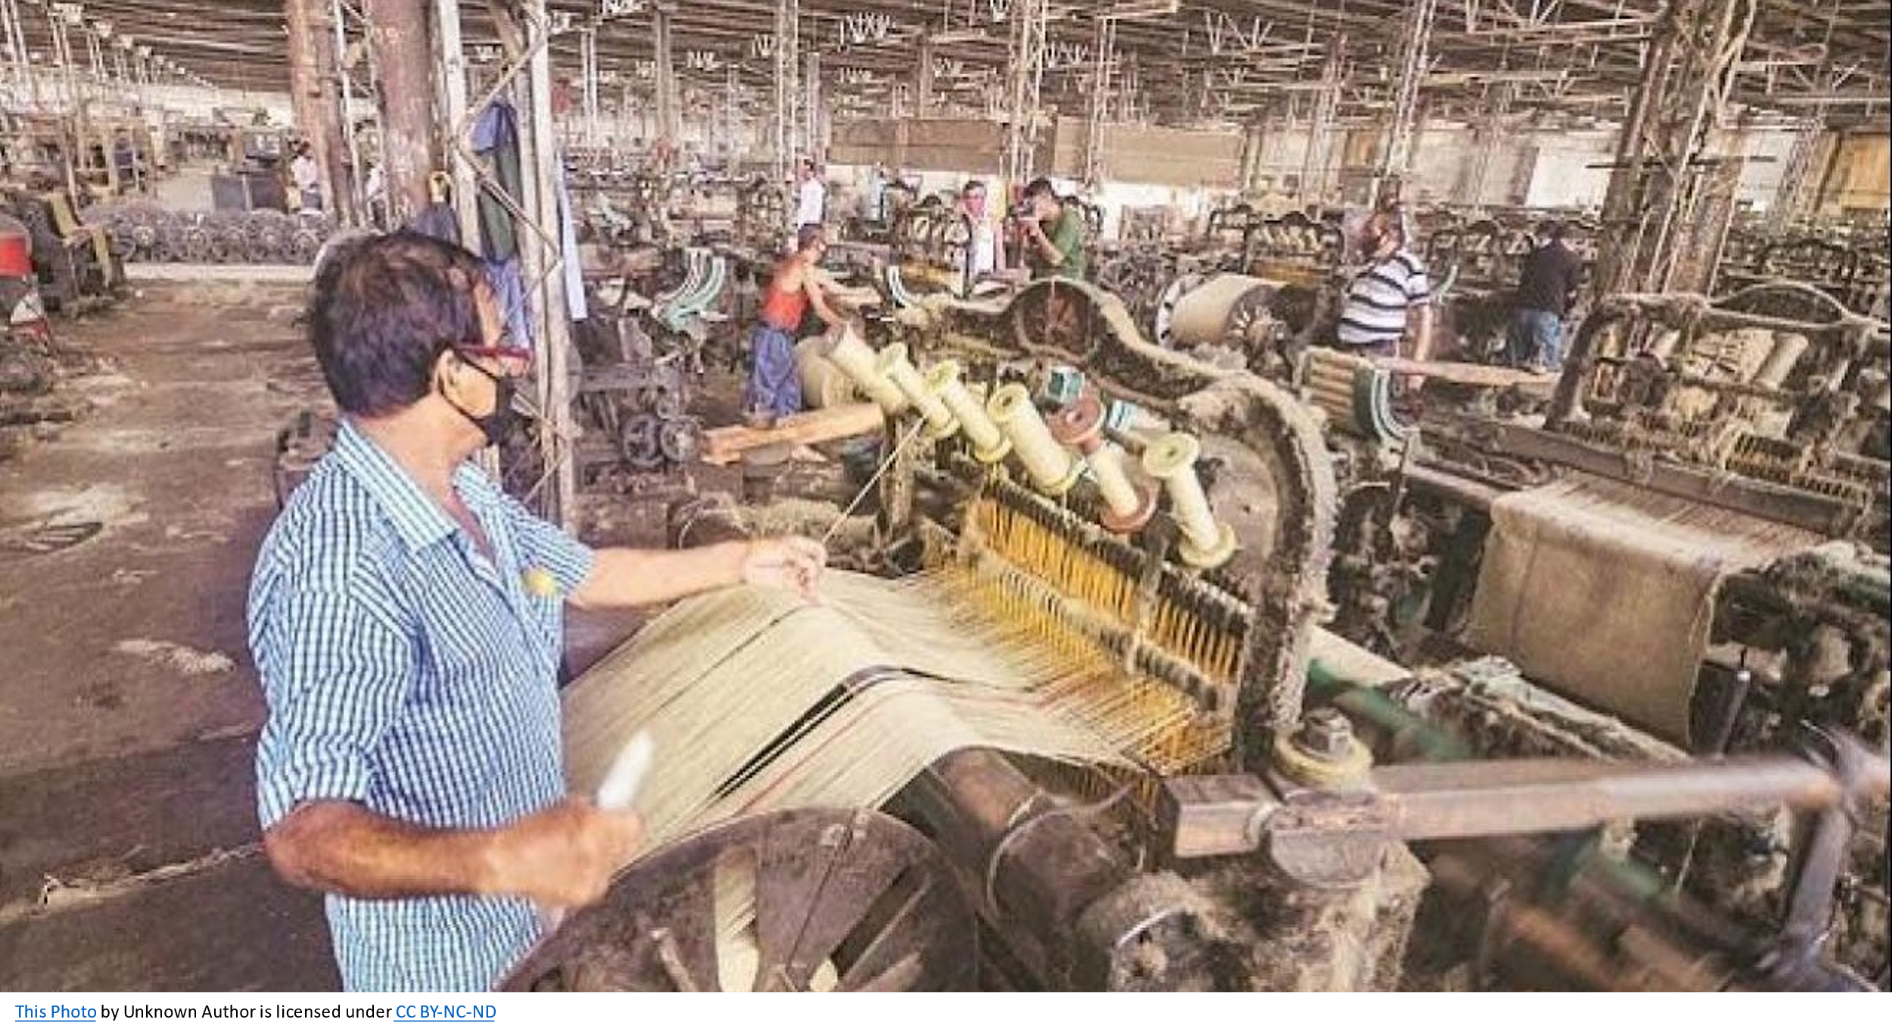
INTRODUCTION
Unemployment means wastage of precious labour resources of the country.
With the increase in school and college enrolment rates, the proportion of youth in the labour force has been declining.
Youth Employment Opportunities project discusses the unemployment issue which covers a large part of India. It discusses the problems faced by the youth in rural areas due to lack of proper knowledge and guidance.

Slide 3

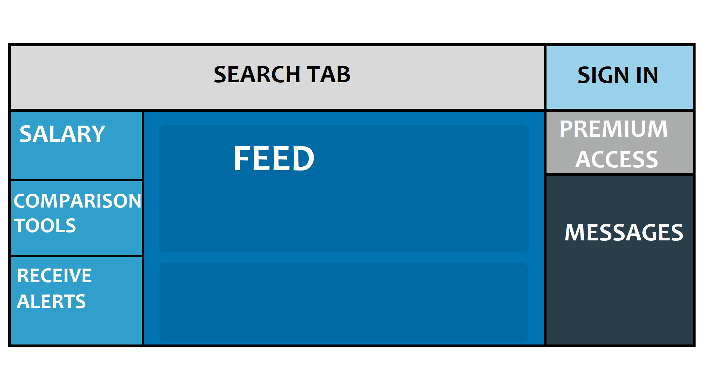


OBJECTIVE OF PROJECT
The main aim of this project is to create a user friendly and language compatible website for the people of rural area to help them with the employment issues that they might face.
In this context, the project offers recommendation for increasing productive employment and reduction in unemployment for the youth.

Slide 4



EXISTING SIMILAR PROJECTS / APPLICATION STUDY
Indeed :- It posts listings for job seekers in every industry, every level, and every lifestyle like freelance, part-time, internship or full-time. Indeed uses more than 130 technologies including HTML5, Google Analytics and jQuery.
Monster :- This site also offers salary comparison and research tools and provide premium resume makeups .
LinkedIn:- This site acts as a database for open opportunities, a digital resume platform, and an all in-one social networking tool. It is also the one of the most popular sites for finding a suitable job in the recent times. The technologies used in LinkedIn are mostly Java with some Python, Ruby, Node and C++.
However, the gap/issue in these sites is that most of these websites offer more specialized or niche jobs which may not be suitable for every candidate , in every industry , skill level and pin code.
This Photo by Unknown Author is licensed under CC BY
This Photo by Unknown Author is licensed under CC BY-SA-NC

Slide 5

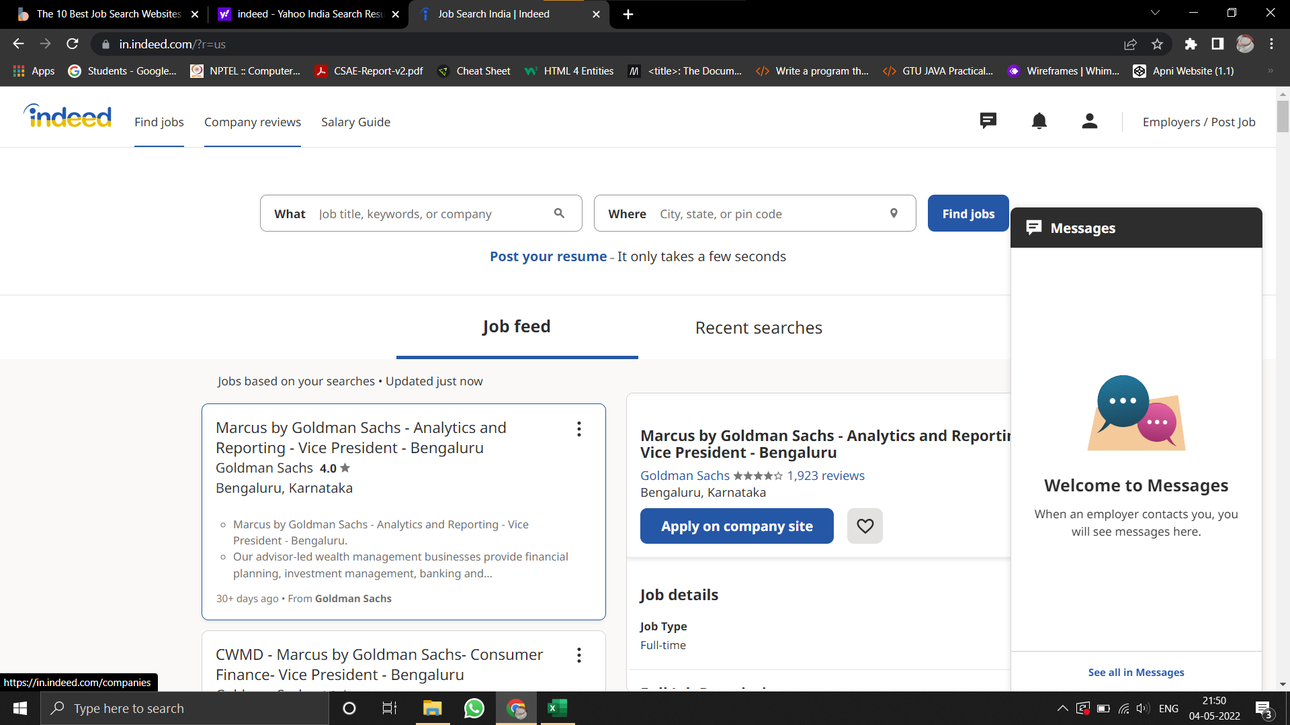
Indeed Interface
Part-1

Slide 6
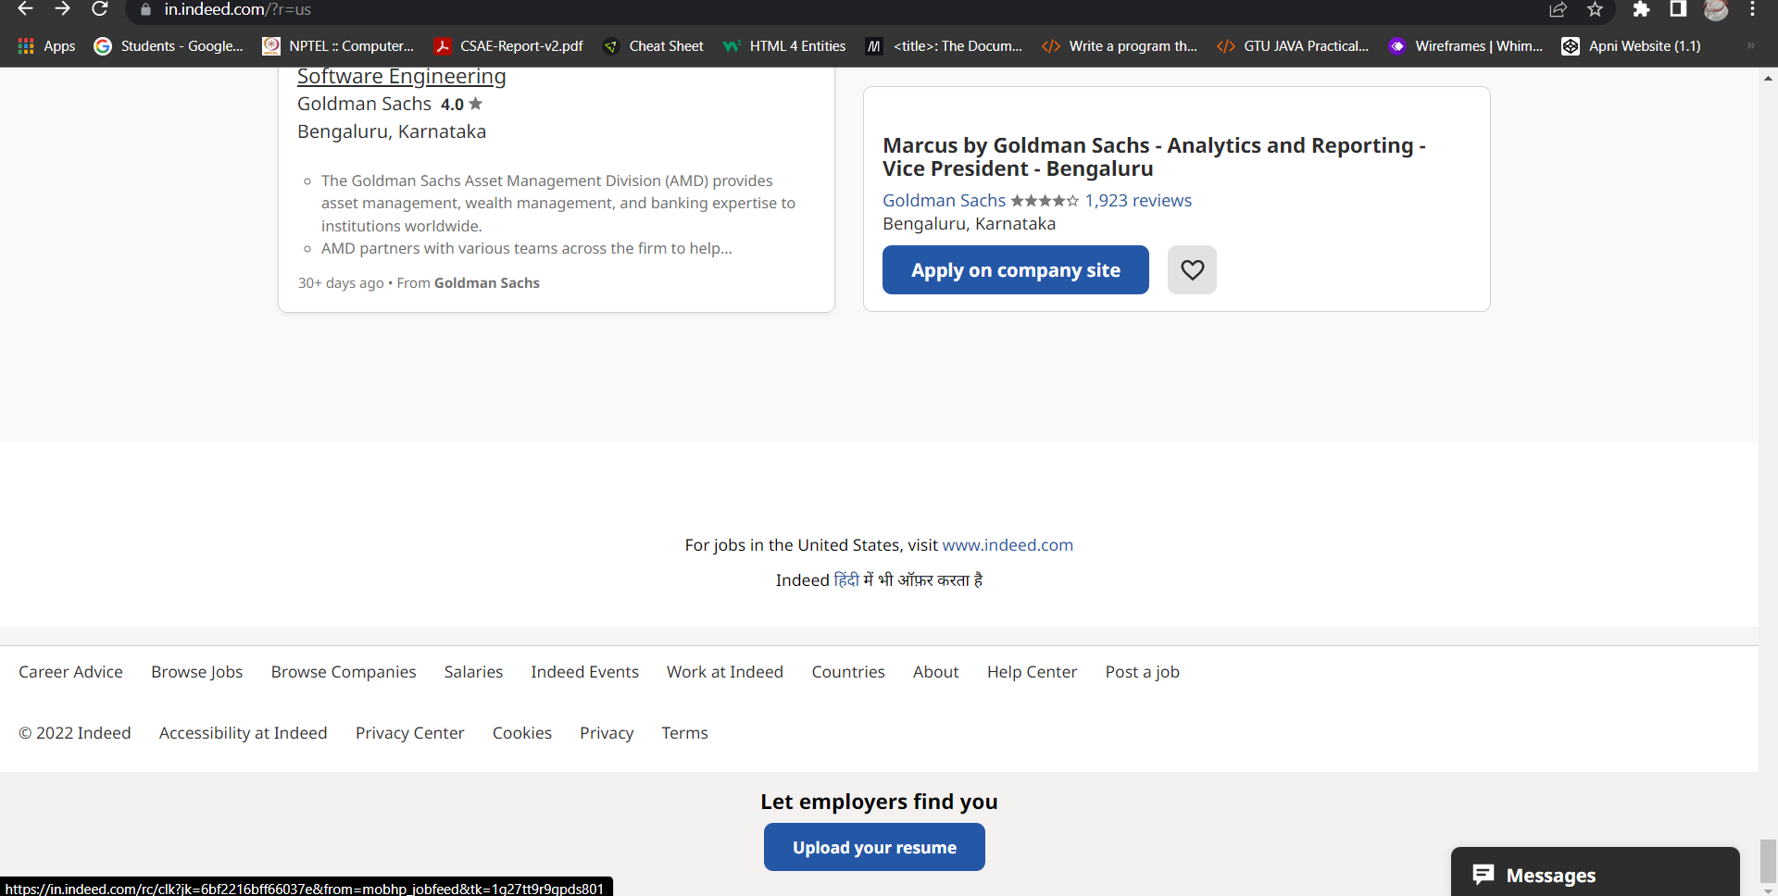
Indeed Interface
Part-2

Slide 7


LinkedIn Interface
Desktop View

Slide 8
RESEARCH GAP
Sr no. | Paper Title | Paper Author | Published Year | Summary
1 | The evidence is in: How should youth employment programs in low-income countries be designed? | Louise Fox and Upasana Kaul | 2017 | This research examines the barriers to youth transitioning into work in low-income nations. It looks at which employment initiatives and policies appear to help youth make the transition faster, with a focus on establishing new job opportunities for them. ^{[3]}
2 | Opinion of youth on issues and challenges related to Employment: A study in Mysore city | Dr Mohan A.K | 2016 | Unemployment rates are normally considered as employment inadequacy for youth. In India, from 2000-to 2010 the share of employment in the industry and service sector continued to grow while agriculture employed fewer workers. Poor quality of educational services is producing a workforce lacking the basic knowledge and skills needed for today's job. ^{[4]}
3 | Challenges Of Decent Employment In India | Shamim Ara | 2021 | This article examines employment challenges in India in the ILO’S decent work framework. Remarkably, jobs were created in the organized sector, in the regular salary category, and in the services sector in 2017-18. However, the rate of employment growth in these segments is very low and cannot offset the net loss of employment in the unorganized sector, temporary jobs and agriculture and manufacturing, particularly in rural areas. The article advocates for urgent policy interventions to ensure access to productive and decent work for all in India. ^{[5]}

Slide 9



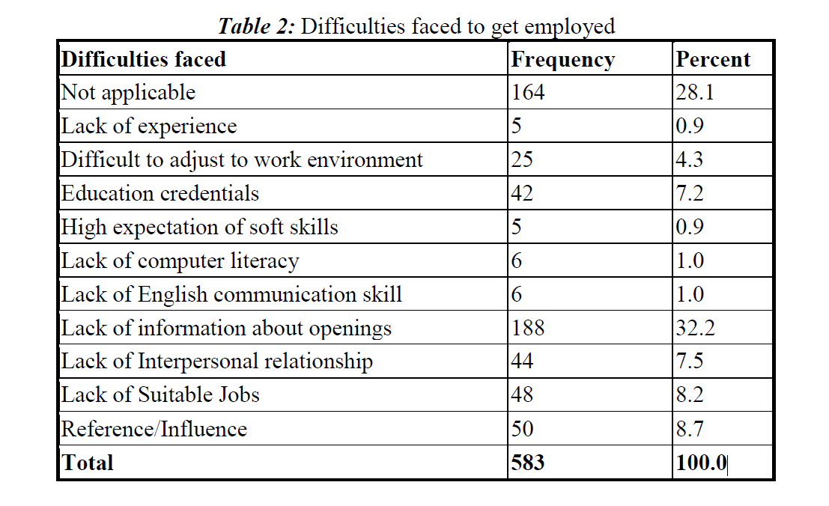



Problem Summary
Although with the increase in school and college enrolment rates, the proportion of youth in the labour force has been declining, their high proportions in the labour force indicate that the problem of youth unemployment and underemployment would remain a serious issue in India for many years to come.
Here, through this project, we show various job openings as well as the sources through which the dream jobs can be acquired.
The language selection is an add-on to reach maximum people.
The table given here shows the difficulties faced in the way of getting jobs.[4]
This Photo by Unknown Author is licensed under CC BY-SA
This Photo by Unknown Author is licensed under CC BY-SA
This Photo by Unknown Author is licensed under CC BY-NC
This Photo by Unknown Author is licensed under CC BY-SA
This Photo by Unknown Author is licensed under CC BY-SA

Slide 10
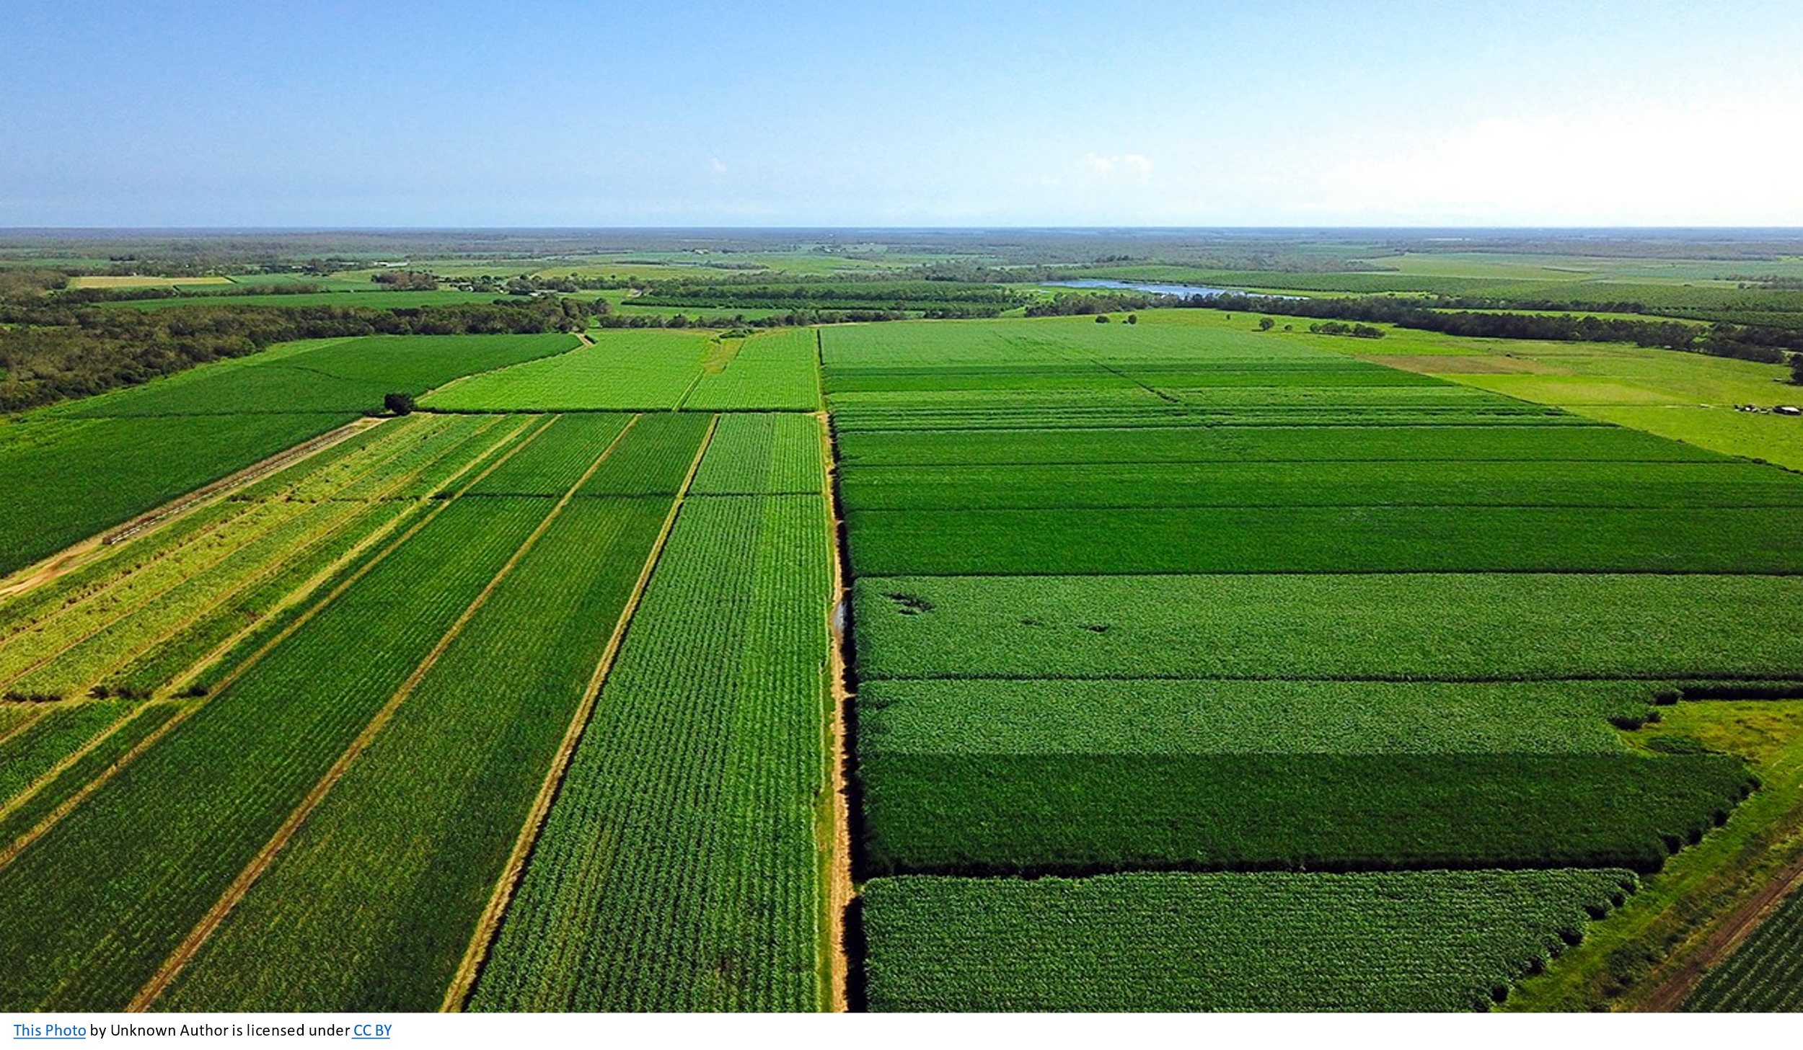
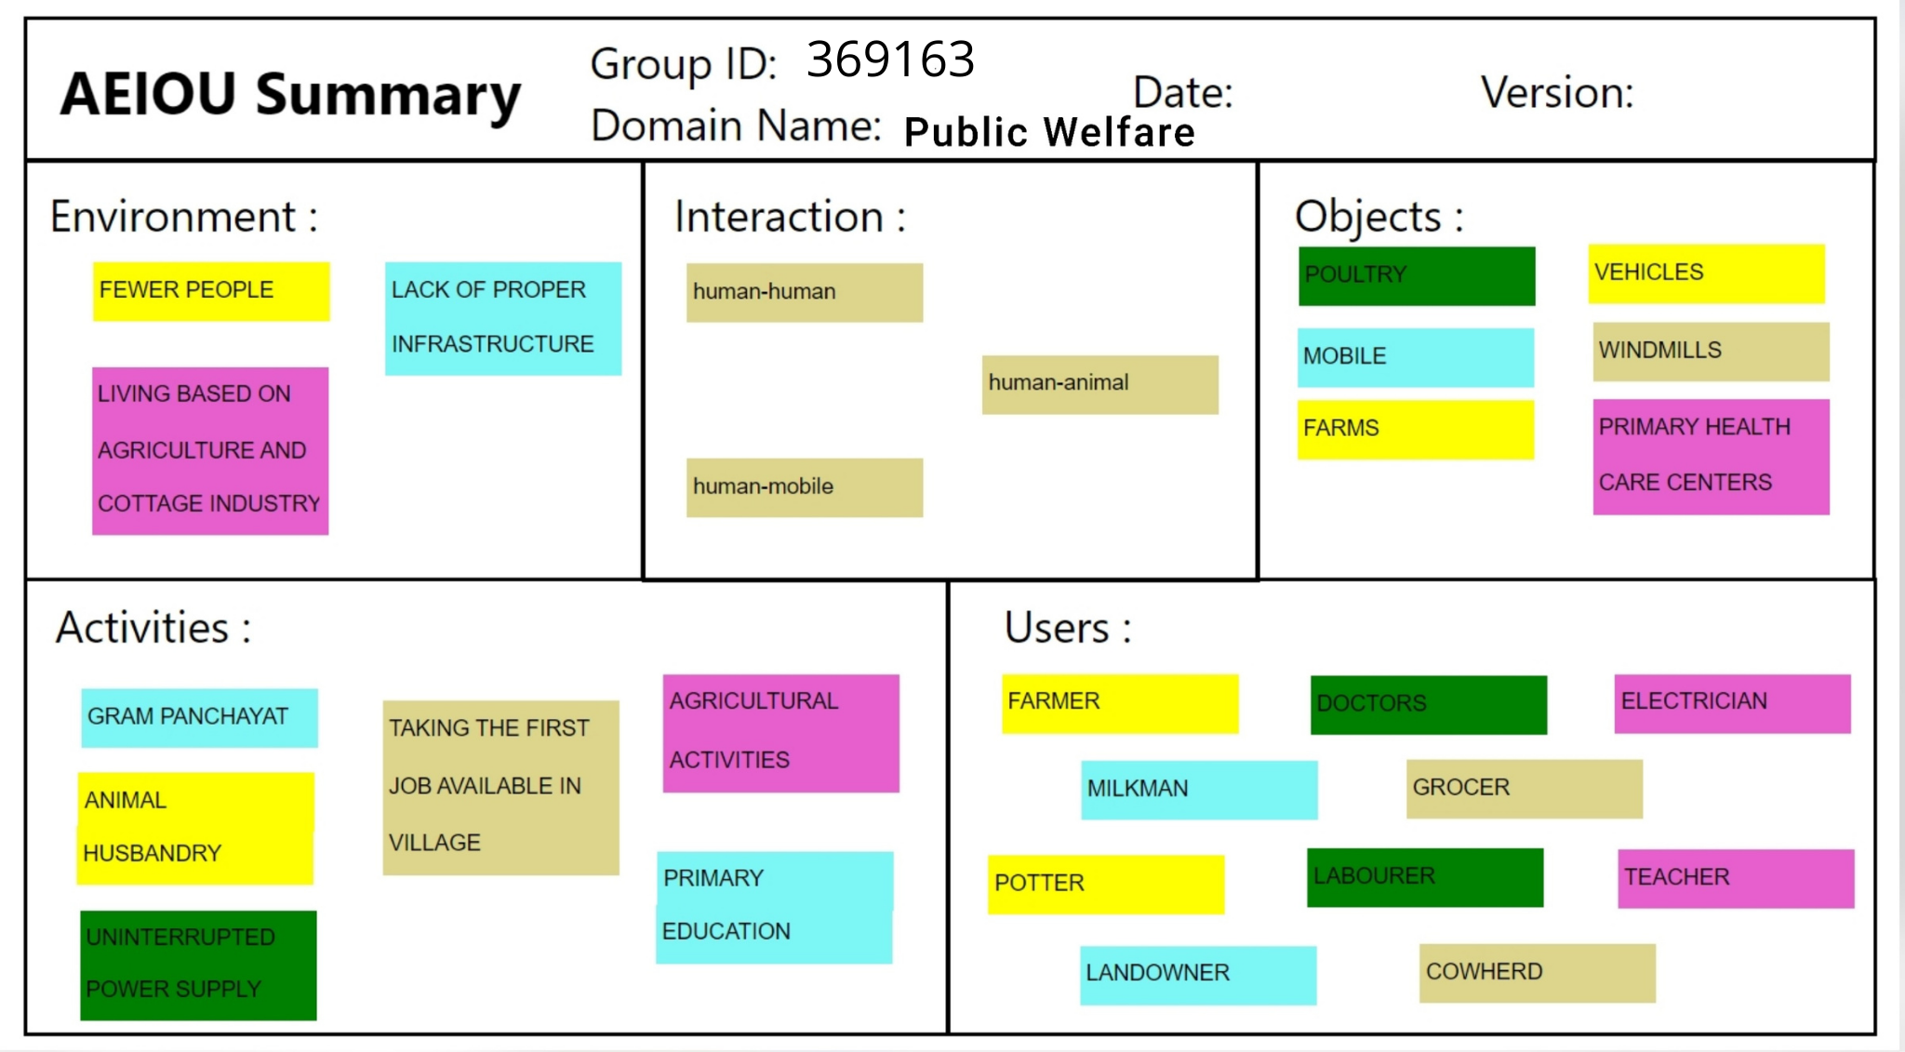
AEIOU CANVAS

Slide 11

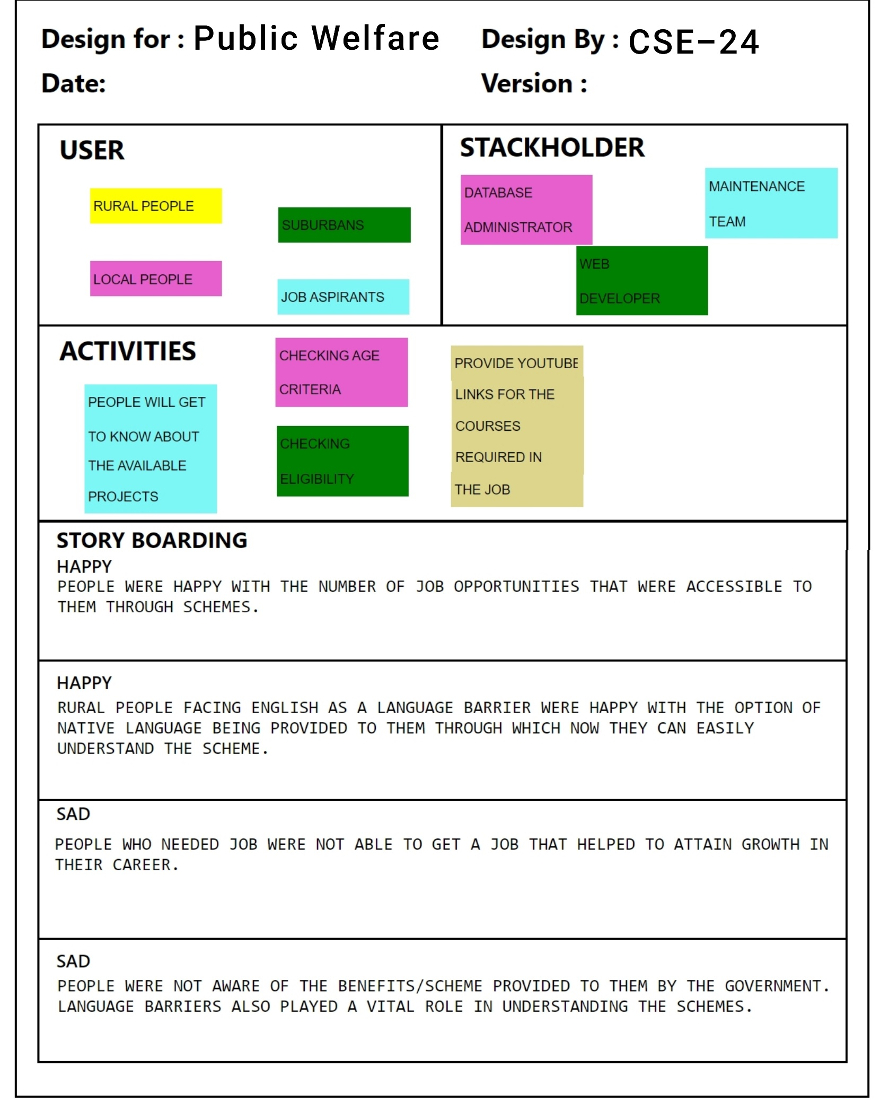
EMPATHY CANVAS

Slide 12
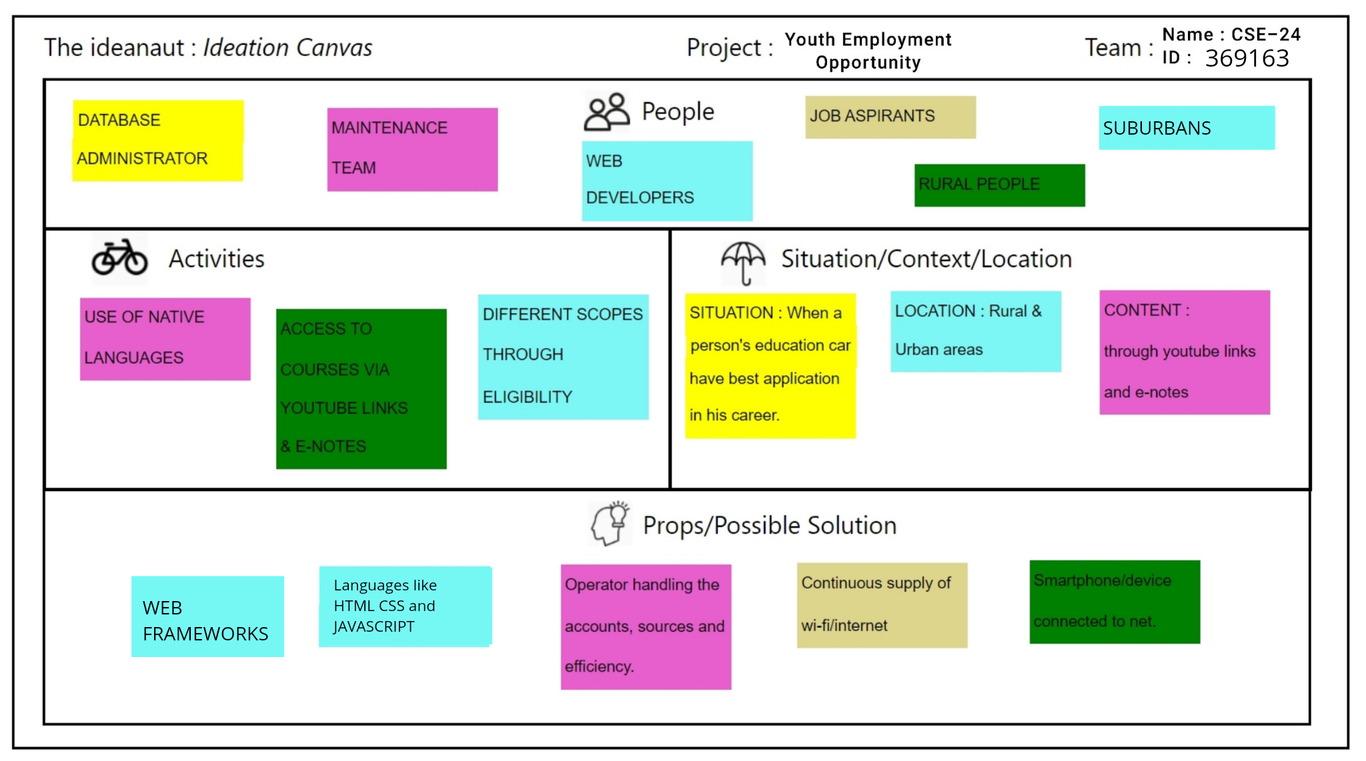
IDEATION CANVAS

Slide 13
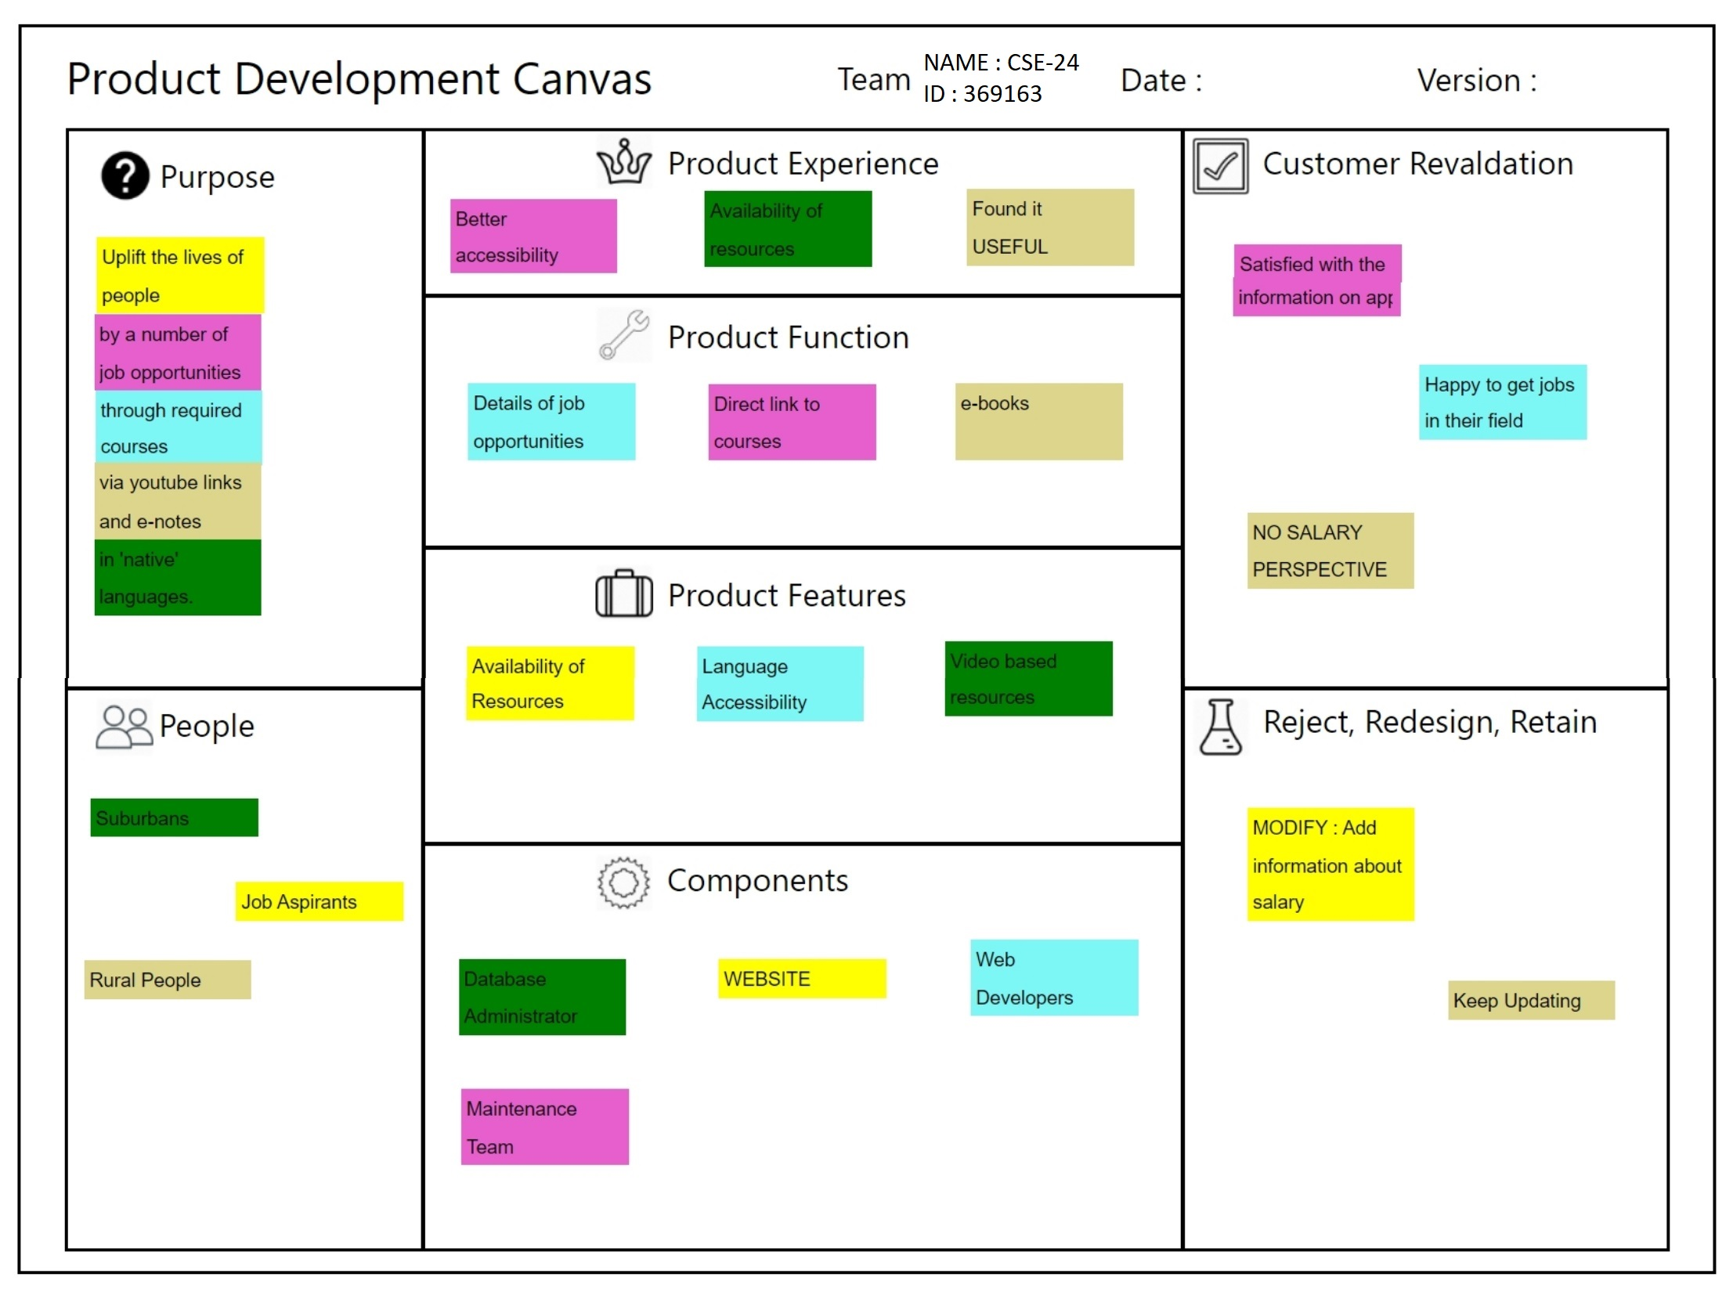
PRODUCT DEVELOPMENT CANVAS

Slide 14
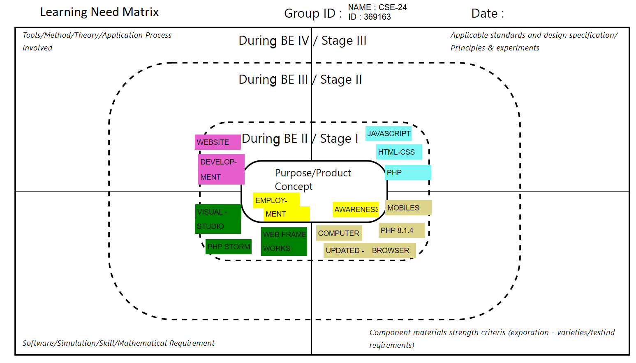
LEARNING NEED MATRIX

Slide 15

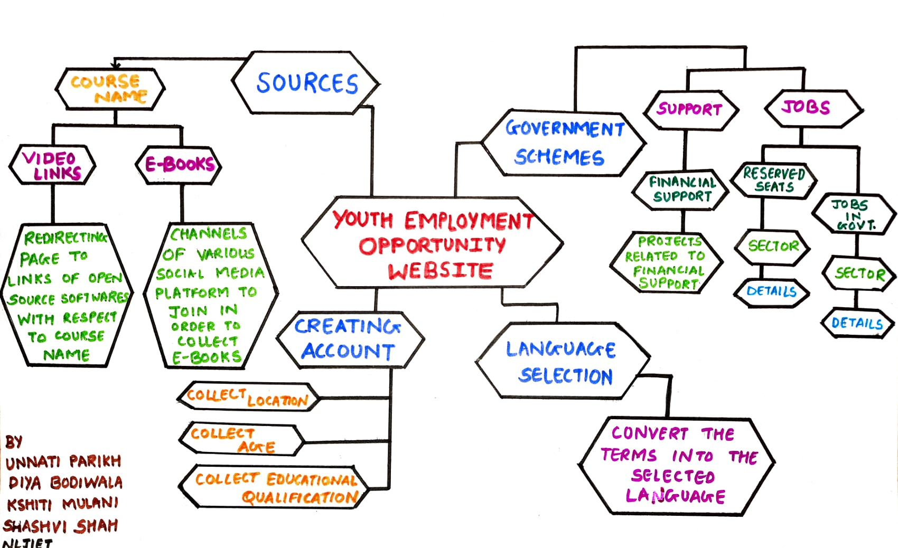
MINDMAP

Slide 16
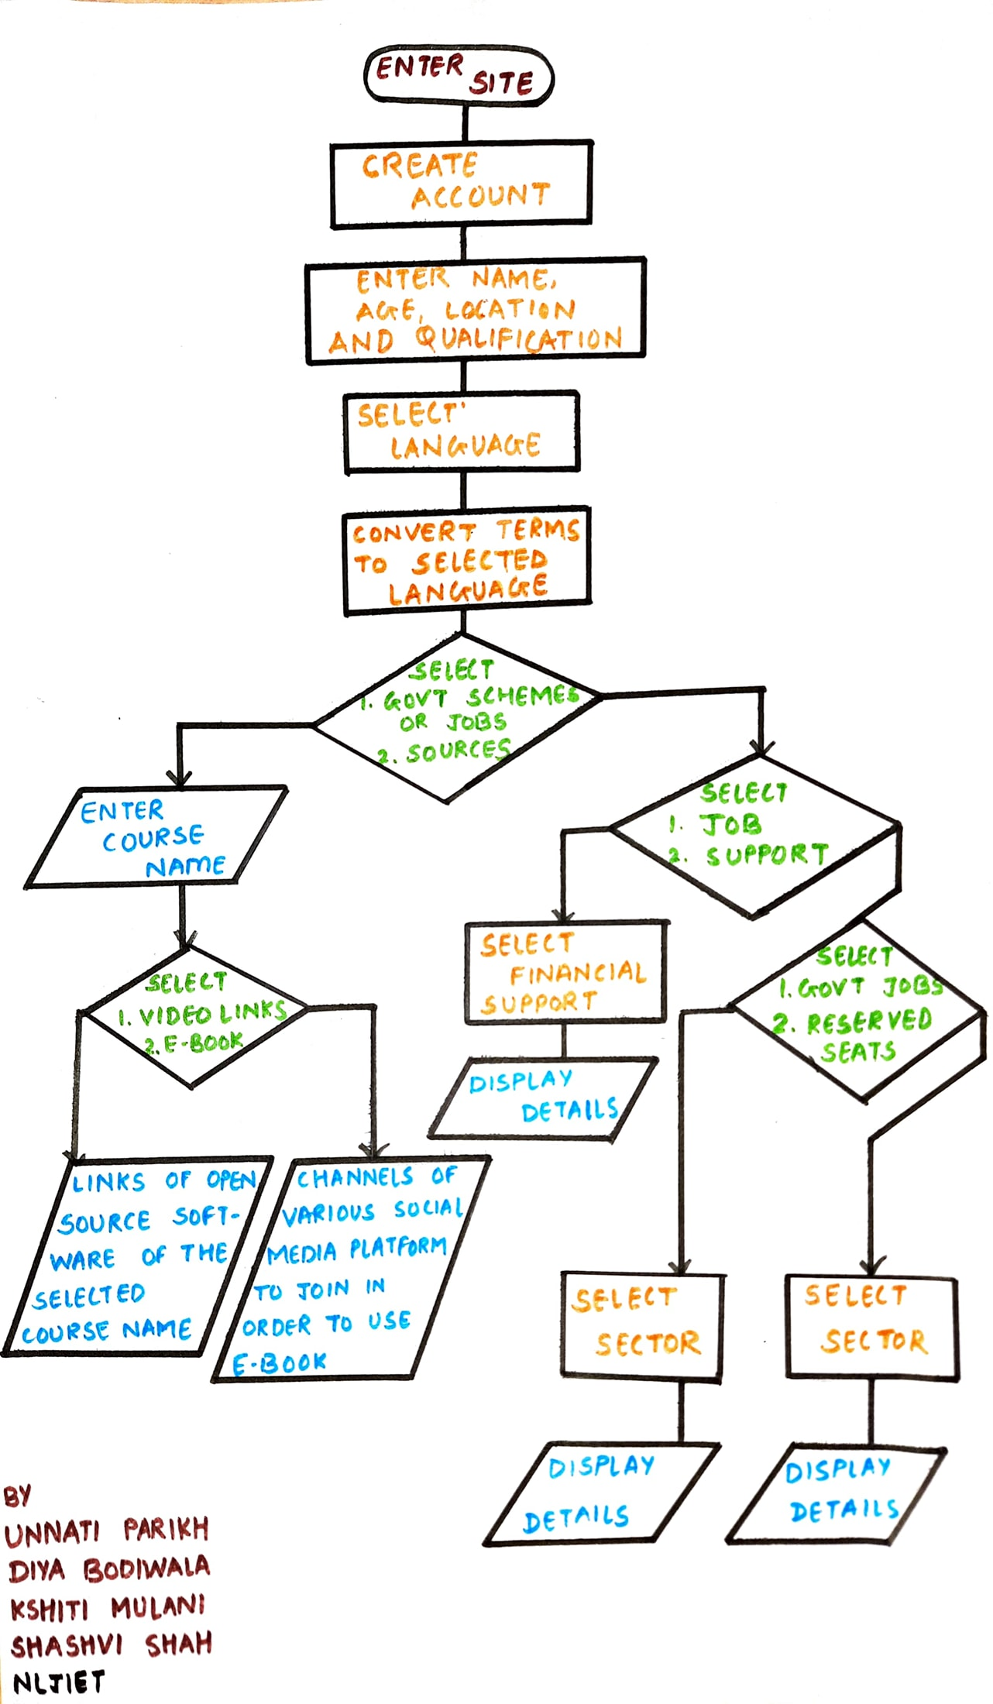
PROTOTYPE
Flowchart

Slide 17
HARDWARE / SOFTWARE REQUIREMENTS
Tools used to develop the website include apps like
Visual Studio
PHP Storm (latest versions to support new developments).
The programming languages required for developing websites include
HTML – CSS
JavaScript
PHP
Web frameworks.
Website can be accessed through
Phone
Computer (with updated browsers)

Slide 18
MODULES
Database Administrators – To handle the data and upload it on time.
Web Developers – To develop the website along with the updated features.
Maintenance Team – To handle the system crash or server issues when user accession leads to server crash.
Users – Accessing the resources available.
Connection with servers that helps to collect information and resources on timely basis.

Slide 19
FEATURES
Daily updating about the job openings.
Language accessibility.
Conceptual learning through e-books and open source softwares.

Slide 20
LIMITATIONS
No comparison tools available
No salary prospects are mentioned

Slide 21
FUTURE SCOPE
Can include message facilities.
Can include reviews about the company or workplace.
Can include Notification updates.
Can include freelancing and internship facilities.

Slide 22
CONCLUSION
Research studies should be carried out to find what factors can affect the employment status of young people.
Proper skill training should be motivated.
Projects that demand more labor and companies providing numerous opportunities should be given more emphasis.
Hiring, promotion and working conditions without gender discrimination are commendable steps in this direction.

Slide 23
REFERENCES
WEBSITES
[1] E. POLNER, “Best Job Search Websites,” 25 March 2022. [Online]. Available: https://www.thebalancecareers.com/top-best-job-websites-2064080
PAPERS
[3] Fox,Louise & Kaul,Upaasna, 2018. "The evidence is in: how should youth employment programs in low-income countries be designed ?," Policy Research Working Paper Series 8500, The World Bank.
[4]Dr. Mohan A.K, “OPINION OF YOUTH ON ISSUES AND CHALLENGES RELATED TO EMPLOYMENT: A STUDY IN MYSORE CITY” International Journal of Research – Granthaalayah, Vol. 4, No. 4 (2016): 1-7. https://www.cukerala.ac.in/cukpdfs/IQAC/3.4.5/3.4.5.DSW.027.pdf
[5] Shamim Ara (2021). Challenges of Decent Employment in India. Indian Journal of Finance and Economics, Vol. 2, No. 2, pp. 163-185. https://arfjournals.com/image/catalog/Journals%20Papers/IJFE/No%202%20(2021)/5_Shamim_Final.pdf

